Slide 1
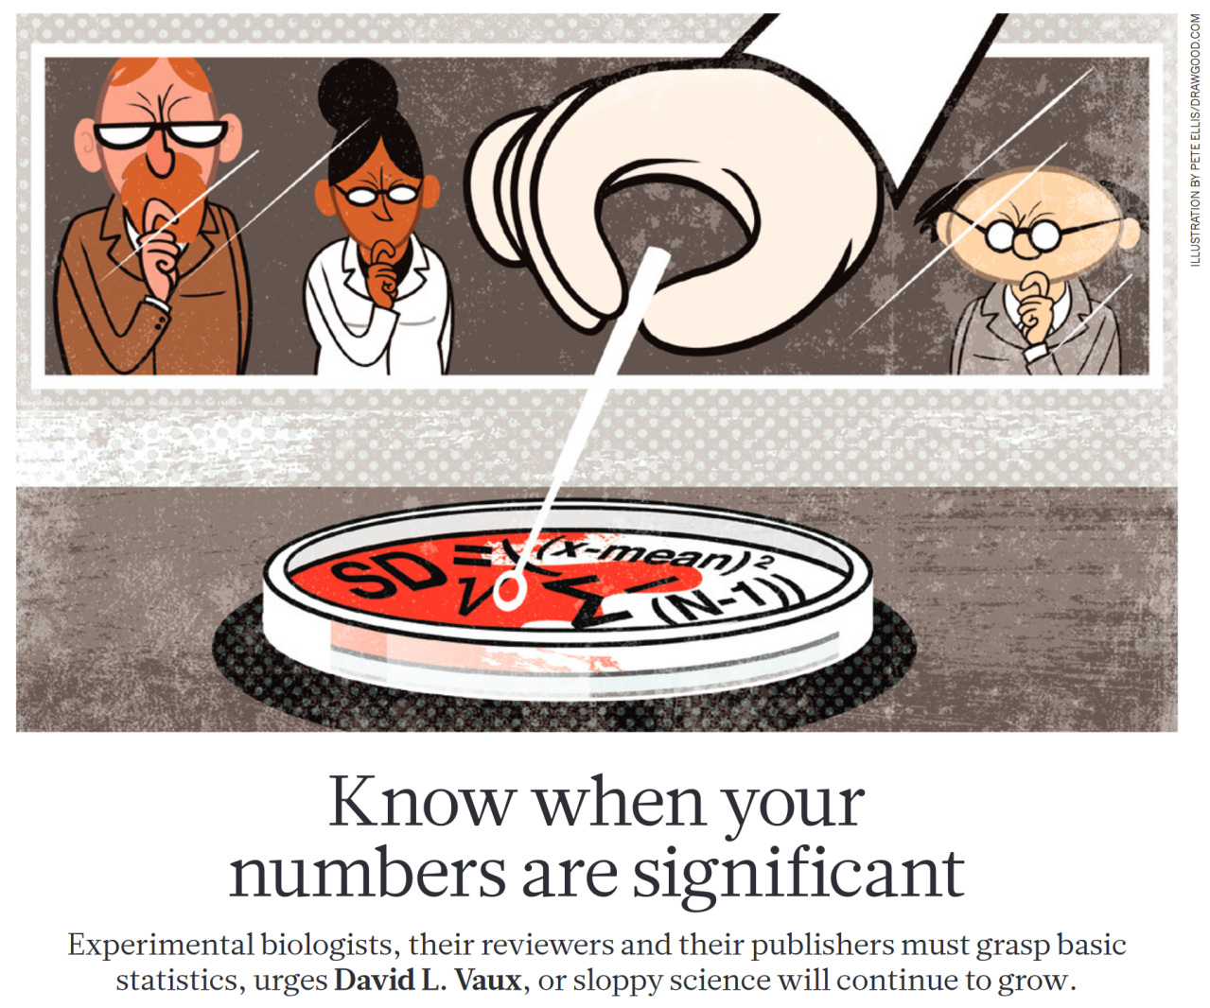
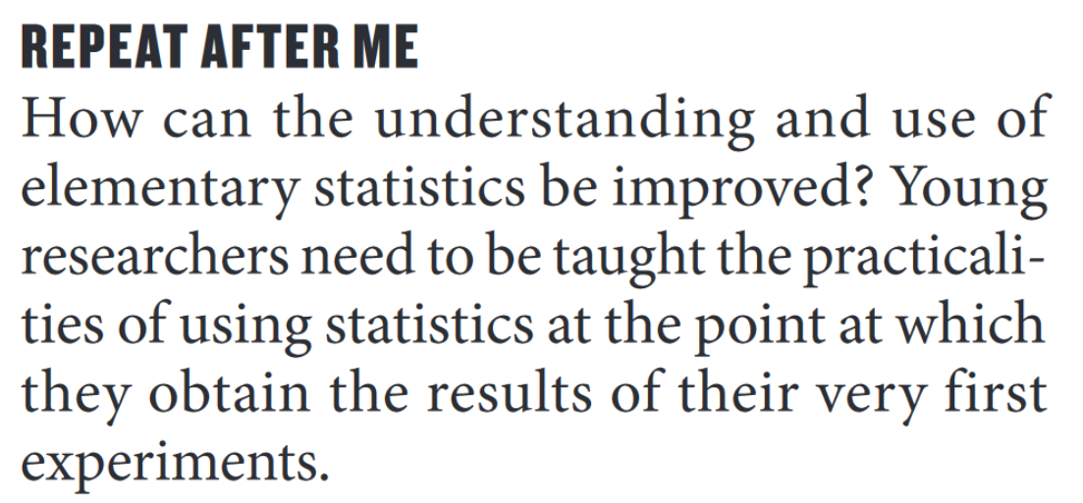

Source: David L. Vaux , Know when your numbers are significant, Nature 492, 180–181 (13 December 2012) doi:10.1038/492180a
Notes:
In english / question ok (not to many) / questions in dutch ok
Elementary statstics (this Friday/next Friday) –already had statistics -> what is p-value/what is significant?
No formulas / no code
Will show example questions at the end of the next lesson
We can go slowly
You did probably not choose this biomedical direction for the statistics / nor for programming, but
Also in other fields very important -> chemistry / psygologie / sociologie / economie

Slide 2
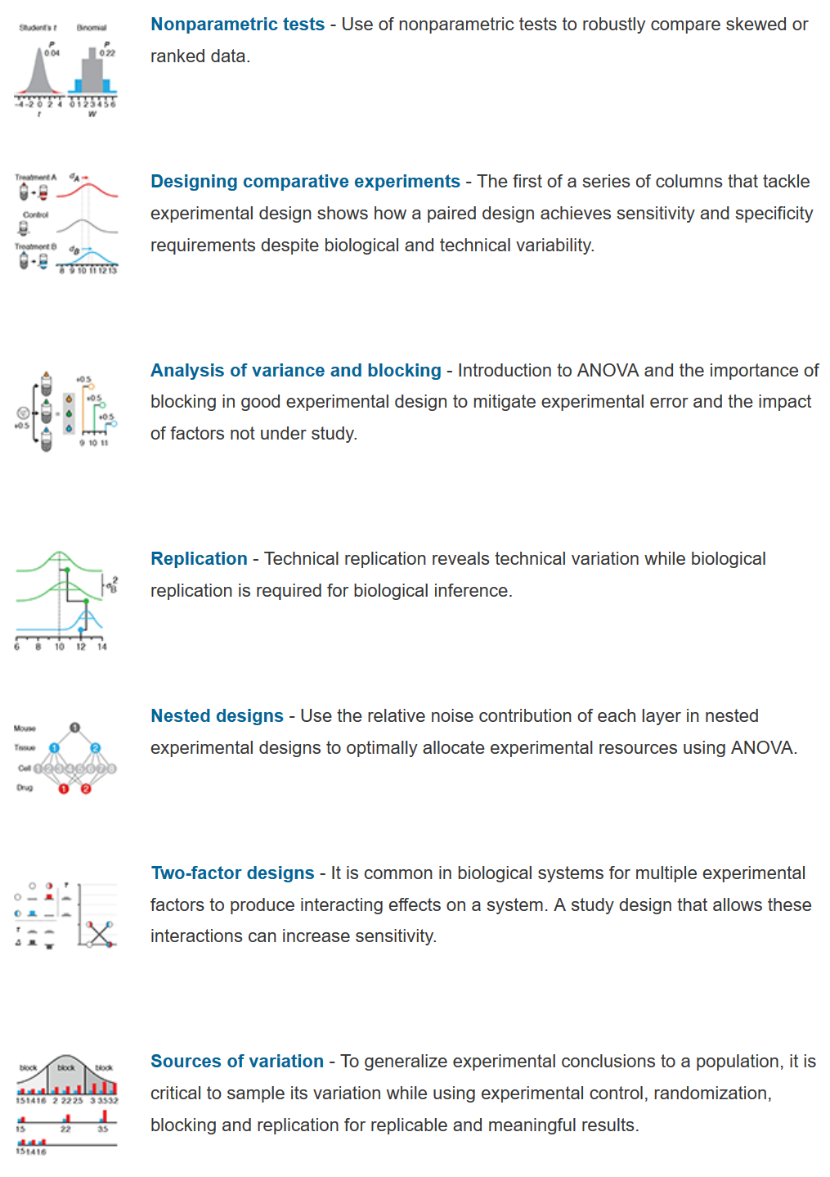
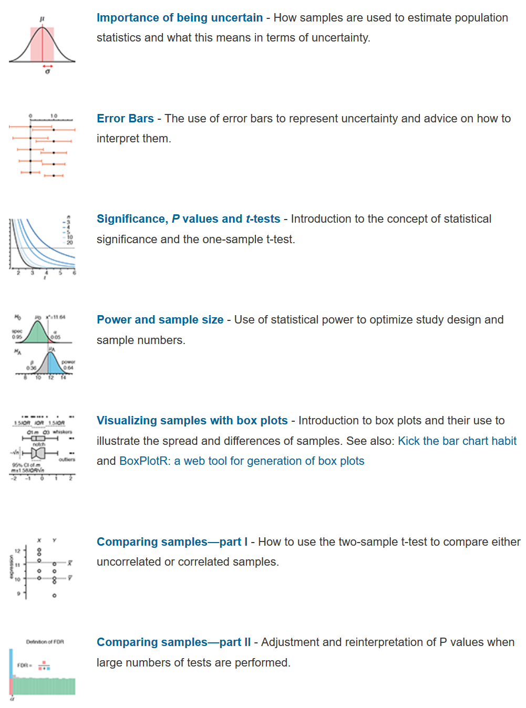
Since September 2013 Nature Methods has been publishing a monthly column on statistics called "Points of Significance."
Source: http://www.nature.com/collections/qghhqm/pointsofsignificance

Slide 3
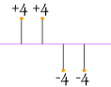
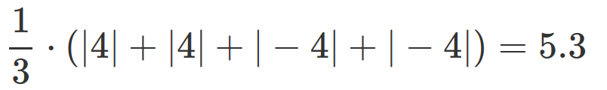
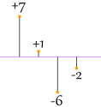
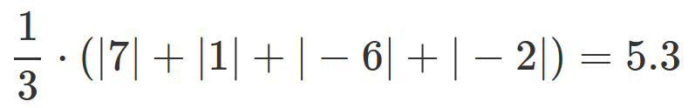
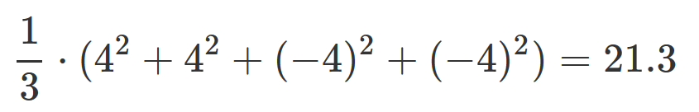
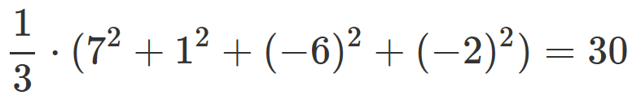
Intermezzo: sum of squares
Why use the sum of the squared difference from the mean (sum of squares)?
Imagine we have the following 4 differences from the mean (indicated by the purple line) and we use the absolute value of the difference from mean to compute the variance:
Now consider 4 differences that are more spread out (higher variance):
If we use the squared differences we get a better result:
<
Notes:
Differnece of mean!!!!!

Slide 4
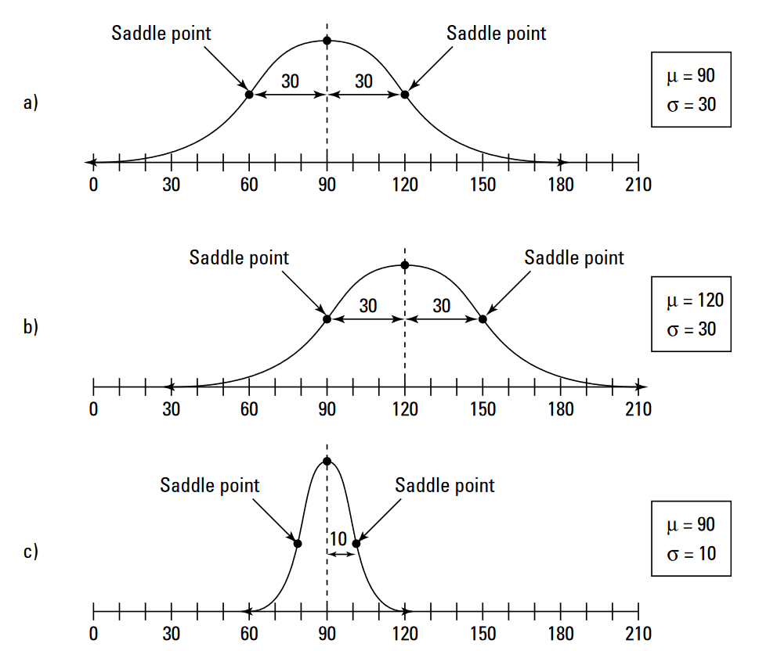
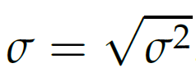
Other population parameters
The standard deviation of a population variable is a more intuitive measure of spread of a variable and is computed as the square root of the variance:
It is also the distance from the mean out to either saddle point in a normal PDF. The saddle points on each graph are where the PDF changes from concave down to concave up.
Notes:
Show different types of normal distributions (different means and variances).

Slide 5
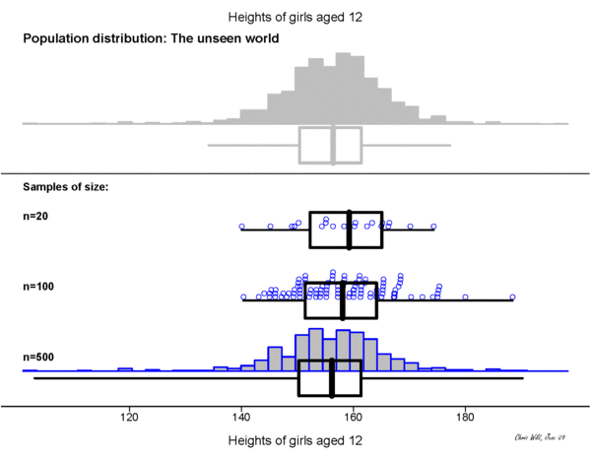
"Towards more accessible conceptions of Statistical Inference" by Chris Wild, Maxine Pfannkuch, Matt Regan and Nicholas Horton published in 2011 in the Journal of the Royal Statistical Society, Series A (Vol 174, pp 247-295)

Slide 6
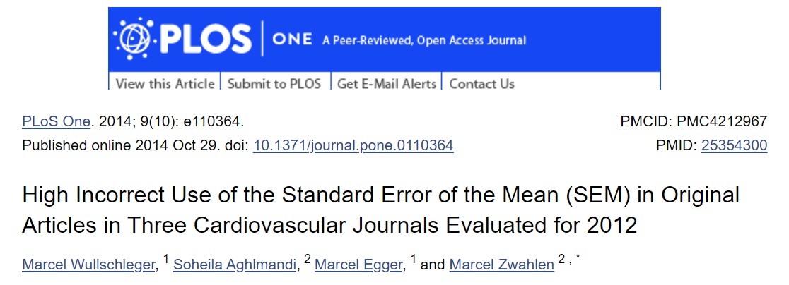

Slide 7
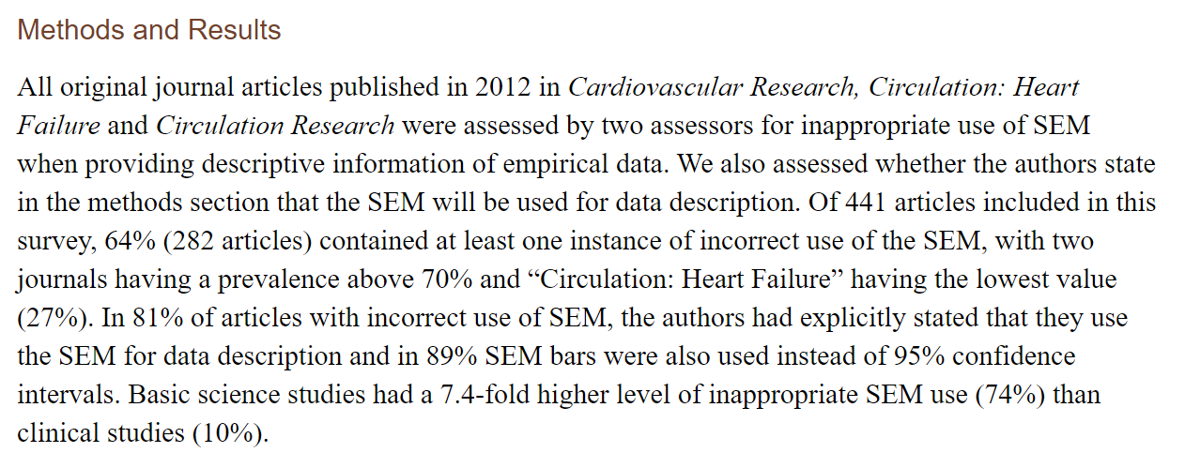
Notes:
why (because someone started doing it and others just did the same + SEM is alsways smaller than std
SEM quantifies uncertainty in estimate of the mean whereas SD indicates dispersion of the data from mean

Slide 8
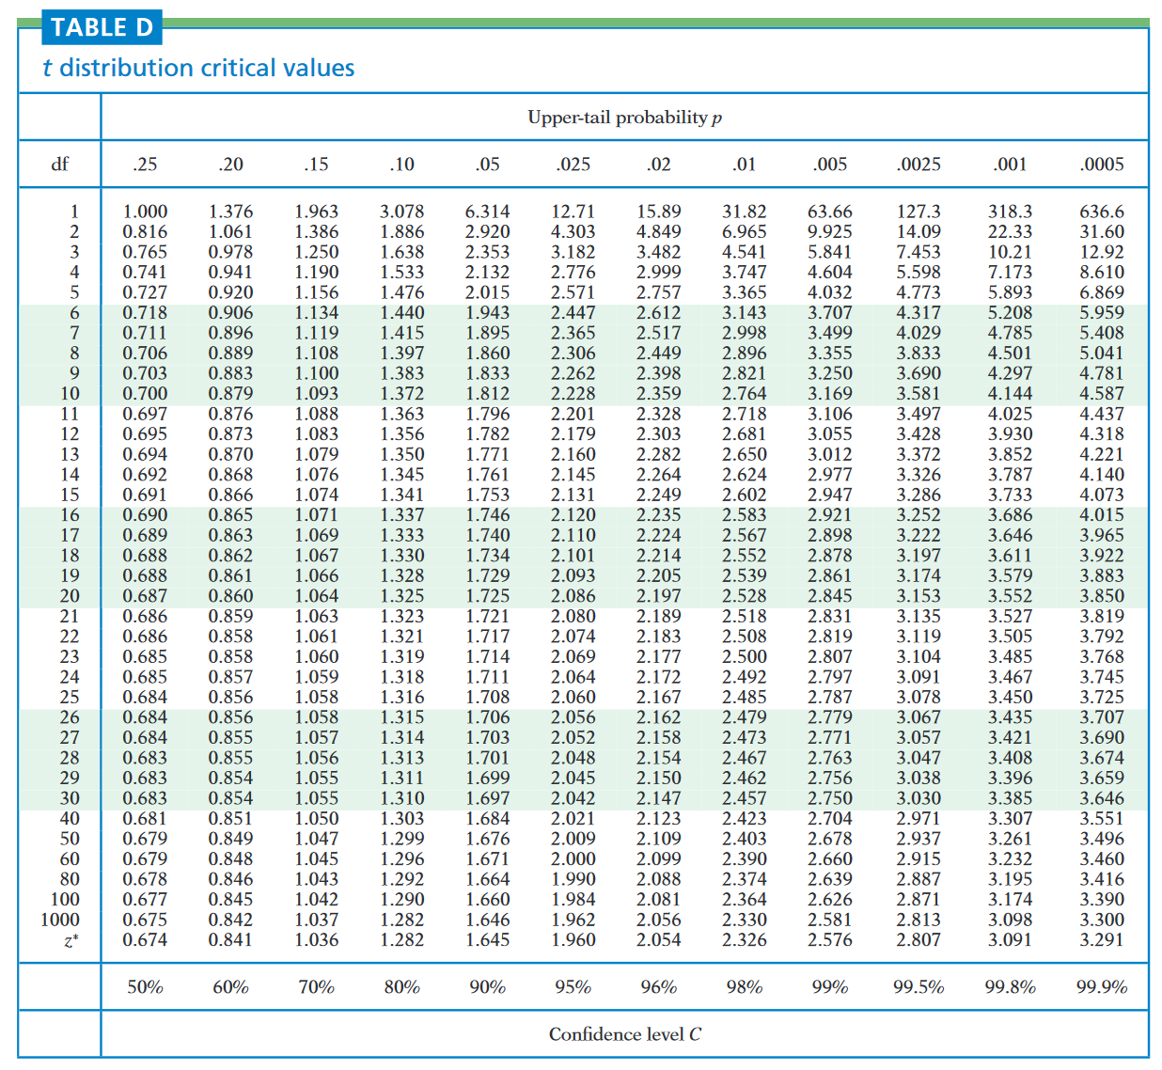
The confidence interval
Which t-distribution to use depends on the confidence level of the CI.

Slide 9
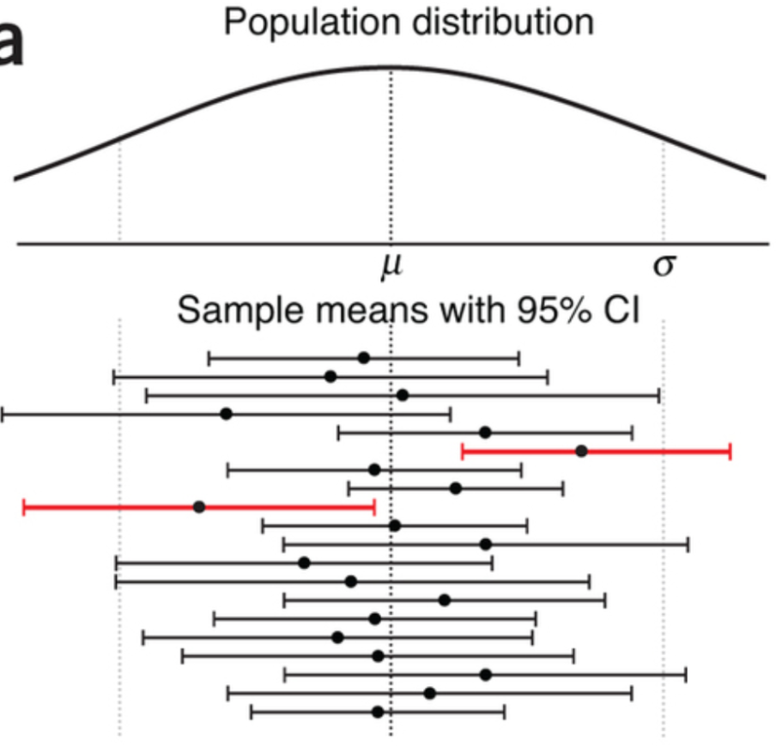
The confidence interval

Slide 10
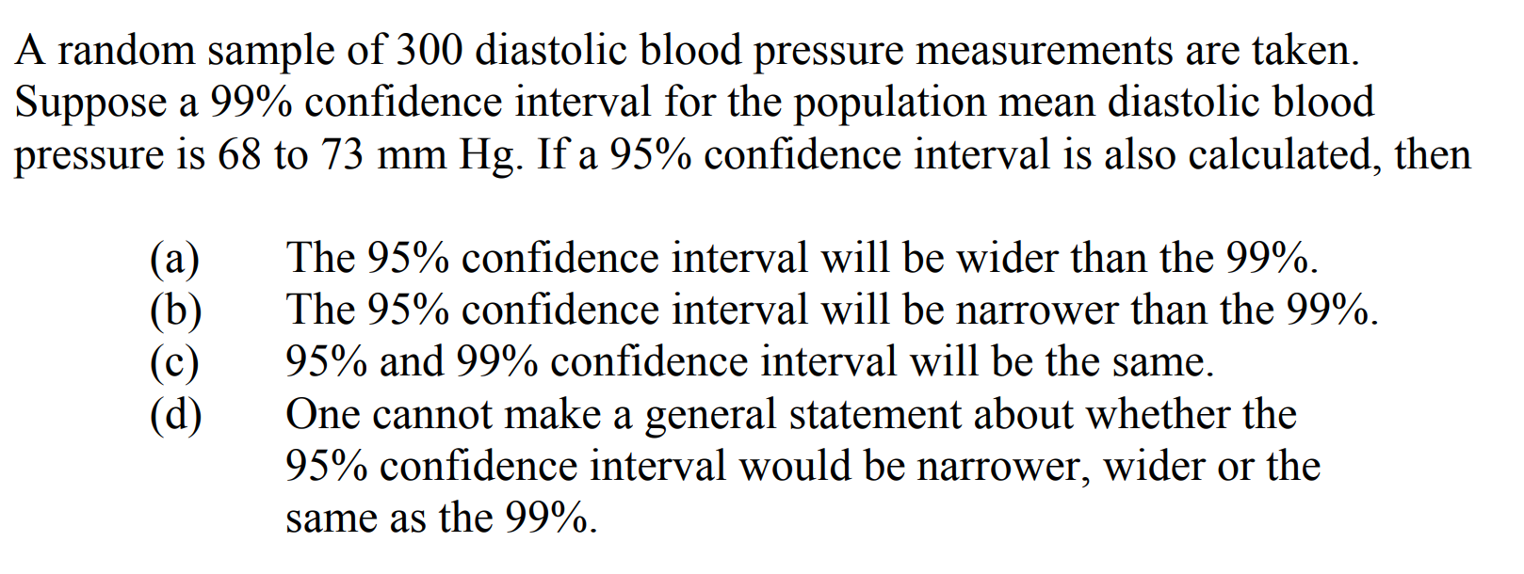
Notes:
b
Assume normality!

Slide 11
Types of statitical analysis
Descriptive statistics quantitatively describe or summarize one or more variables in a sample. They are typically the first kind of analysis performed on the data set.
Inferential statistics quantitatively describe or summarize parameters of the population using a sample. Again, this is based mainly on assumptions made about the population.
Predictive modeling is about using statistics to predict outcomes (typically of future events). In this case each observation is described by an indepedent variable (the variable to be predicted) and one or more dependent variables (used to compute the predictions).
Exploratory data analysis summarizes the main characteristics of the variables in a sample, often with visual methods. It is an approach to analyze data sets to find previously unknown relationships.
Notes:
Machine Learing ...
2 people...

Slide 12
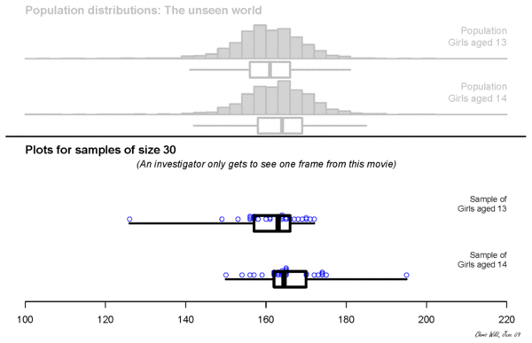
"Towards more accessible conceptions of Statistical Inference" by Chris Wild, Maxine Pfannkuch, Matt Regan and Nicholas Horton published in 2011 in the Journal of the Royal Statistical Society, Series A (Vol 174, pp 247-295)

Slide 13
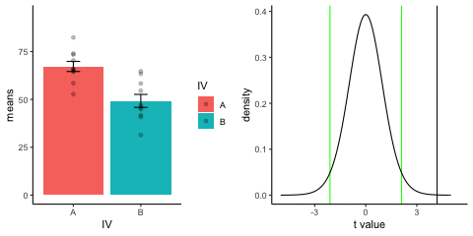
https://crumplab.github.io/statistics/

Slide 14
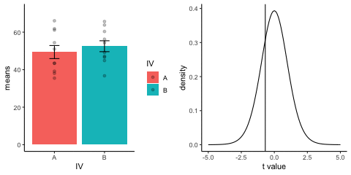
https://crumplab.github.io/statistics/

Slide 15
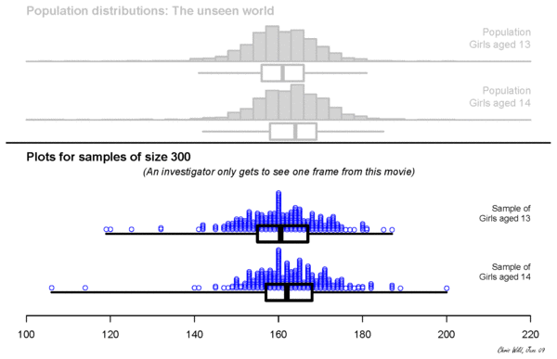
"Towards more accessible conceptions of Statistical Inference" by Chris Wild, Maxine Pfannkuch, Matt Regan and Nicholas Horton published in 2011 in the Journal of the Royal Statistical Society, Series A (Vol 174, pp 247-295)

Slide 16
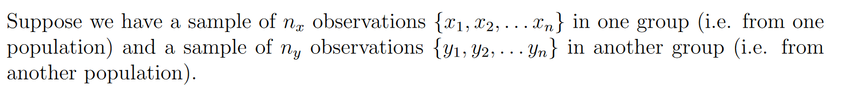
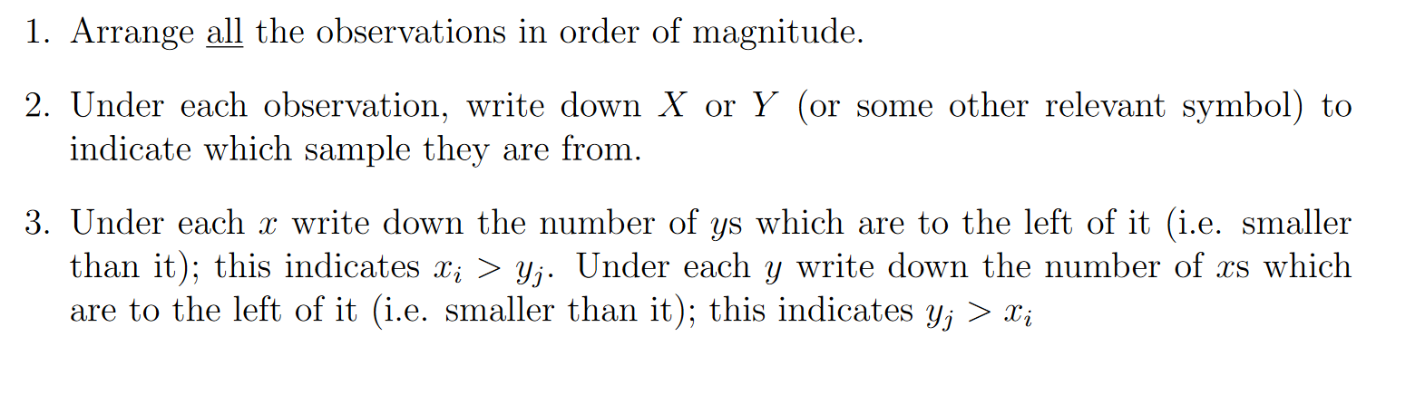
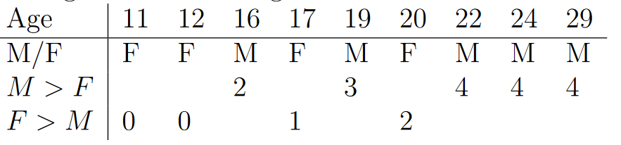
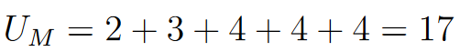
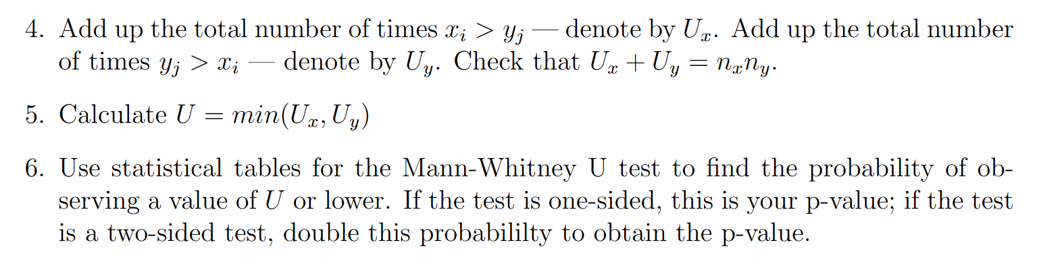
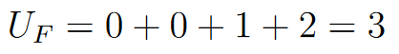
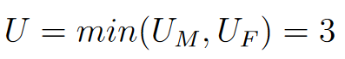
Hypothesis testing: the Mann-Whitney U-Test
The U-statistic is computed as follows.
Notes:
No means, no variance, no std!!!

Slide 17
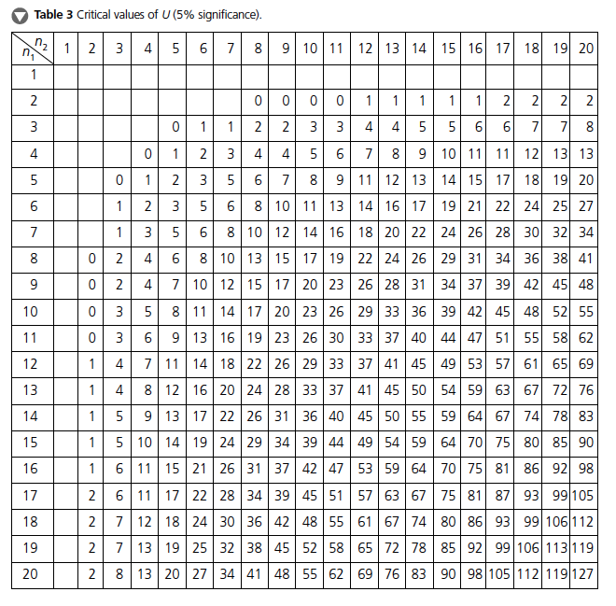
Hypothesis testing: the Mann-Whitney U Test
Notes:
Equal or less then reject null hypothesis.

Slide 18
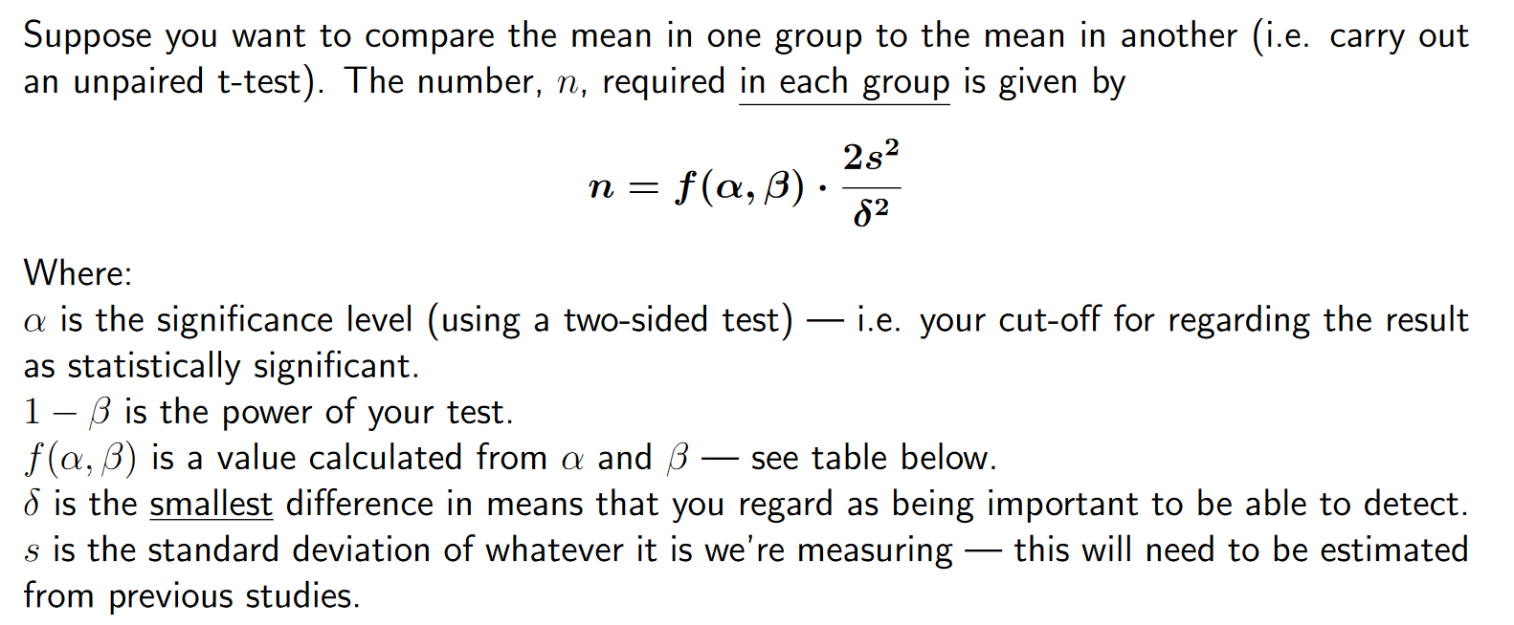
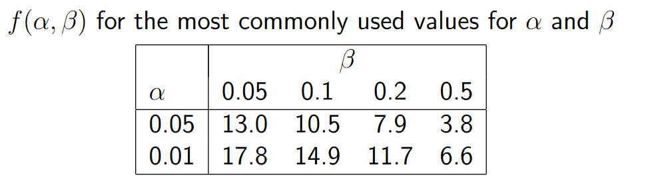
Sample size calculations
Sample size calculation for unpaired t-test:
Notes:
Here you can see how the mean and standard deviation is

Slide 19










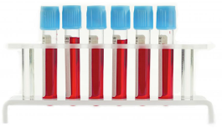
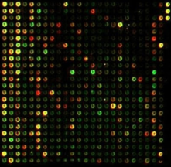
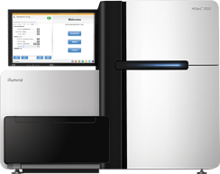
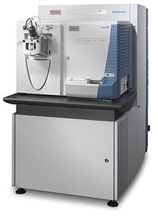

Statistics in biomedical research
In many areas of biology, and especially in clinical research, the statistician
is restricted to small sample sizes
difficult to find representative patients
time/money considerations
is faced with enormous biological variability
many factors influence gene/protein expression
mouse models
is faced with technical variability
sample preparation
machine measurement imprecisions
is not able to control all relevant variables
is interested in small effects

Slide 20
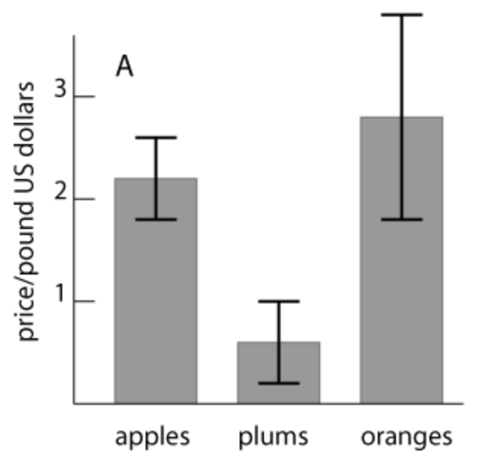
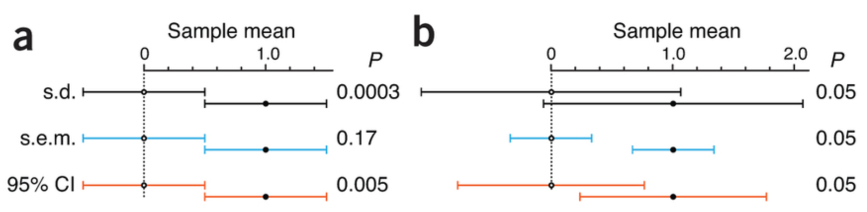
Intermezzo: error bars
The uncertainty in estimates is often represented using error bars.
These can represent the standard deviation, the standard error of the mean or a confidence interval. This needs to be stated in the legend.
Error bars don’t necessarily relate to statistical significance. E.g. is the average price of apples different from the average price of oranges?
Don’t use error bars for small sample sizes (e.g. 3 data points).
Notes:
Fruit in different supermarkets.
Can we say that oranges are more expensive?
What do you think is the best statistic for a error bar?

Slide 21

Sally Clark
https://en.wikipedia.org/wiki/Sally_Clark

Slide 22
Sally Clark
Clark's first son died in December 1996 within a few weeks of his birth.
Her second son died in similar circumstances in January 1998.
A month later, Clark was arrested and tried for both deaths.
The defence argued that the children had died of sudden infant death syndrome (SIDS).
https://en.wikipedia.org/wiki/Sally_Clark

Slide 23
Sally Clark
For an affluent non-smoking family like the Clarks, the probability of a single cot death was estimated as 1 in 8,543.
So the probability of two in the same family was around 1 in 73 million (8543 × 8543).
Given that there are around 700,000 live births in Britain each year, double cot death would be expected to occur once every hundred years.
https://en.wikipedia.org/wiki/Sally_Clark

Slide 24

Sally Clark
In 2002 the RSS noted that there was "no statistical basis" for the "1 in 73 million" figure.
https://en.wikipedia.org/wiki/Sally_Clark

Slide 25
Sally Clark
The calculation was based on the assumption that two SIDS deaths in the same family are independent.
The RSS argued that there are very strong reasons for supposing that the assumption is false.
“There may well be unknown genetic or environmental factors that predispose families to SIDS, so that a second case within the family becomes much more likely.”
https://en.wikipedia.org/wiki/Sally_Clark

Slide 26
Sally Clark
In a 2004 article in Paediatric and Perinatal Epidemiology, Professor of Mathematics Ray Hill of Salford University concluded, using extensive SIDS statistics for England, that "after a first cot death the chances of a second become greatly increased" by a dependency factor of between 5 and 10.
https://en.wikipedia.org/wiki/Sally_Clark

Slide 27
Sally Clark
Second, it is likely that the court committed a statistical error known as the "prosecutor's fallacy“.
Even if the "1 in 73 million" figure were valid, this should not have been interpreted as the probability of Clark's innocence (p-value).
Murder was not the only alternative explanation for the deaths.
Although double SIDS is very rare, double infant murder is likely to be rarer still, so the probability of Clark's innocence was quite high.
https://en.wikipedia.org/wiki/Sally_Clark

Slide 28
Sally Clark
the probability of a child dying from SIDS is 1 in 1300, not 1 in 8500.
“When a cot death mother is accused of murder, the prosecution sometimes employs a tactic such as the following. If the parents are affluent, in a stable relationship and non-smoking, the prosecution will claim that the chances of the death being natural are greatly reduced, and by implication that the chances of the death being homicide are greatly increased. But this implication is totally false, because the very same factors which make a family low risk for cot death also make it low risk for murder.”
https://en.wikipedia.org/wiki/Sally_Clark

